Slide 1
Kitty Cat Space Map Mockup
Group 16

Slide 2
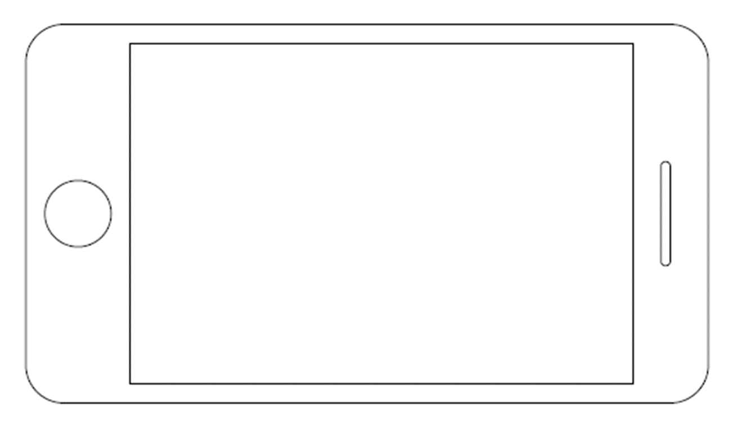
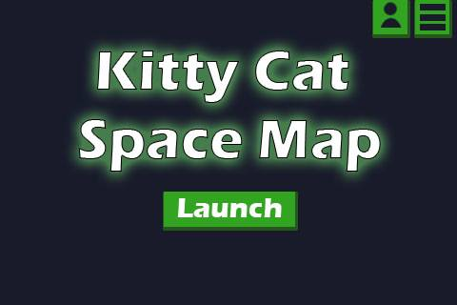
Main Menu
Notes:
This is our main page. This is how you can either start the game, access your account settings and the main menu.

Slide 3
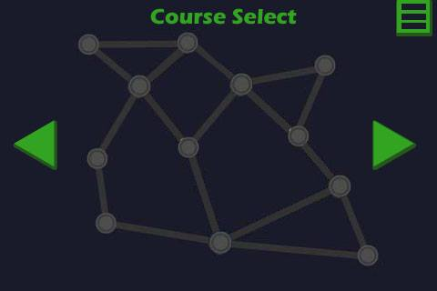
Course Select
Notes:
Immediately after clicking launch, you are sent to the course selection sceen. From here you can either navigate left or right to different courses as you unlock them, or just press on the center to start playing the course in view.

Slide 4
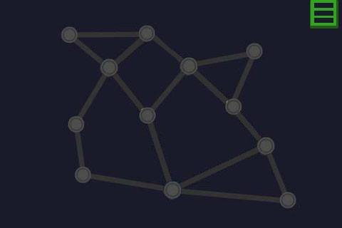
Gameplay
Notes:
You are them displayed an empty map of nodes. If you are a guest user, or this is your first time player then there is the option to view the tutorial, or to skip it and continue to the game.

Slide 5
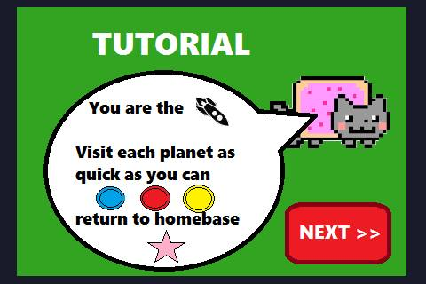
Tutorial
Notes:
Our cat mascot will quickly explain how the game is played. After clicking the “next” button, he will jump into the tutorial level with you giving guidance on how to complete it.

Slide 6
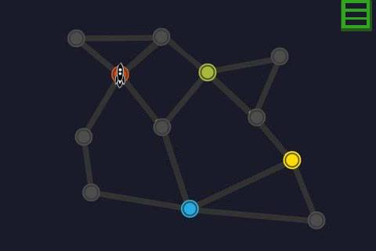
Gameplay
Notes:
The next step of the game is that the map is populated with the player objects, which includes the player’s starting point, and colored nodes to indicate where you are required to go.

Slide 7
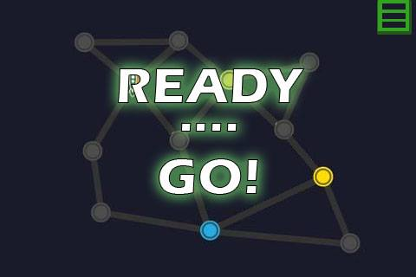
Gameplay
Notes:
Then a quick countdown of ready … go! Is displayed which starts the timer and allows users to input their path.

Slide 8
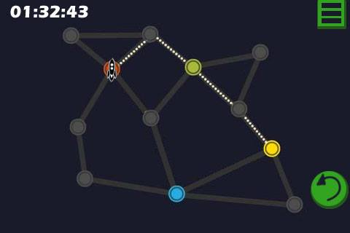
Gameplay
Notes:
The user then needs to start inputing their path as quickly as possible, they are then shown the count up timer and a step back button, which allows users to undo their most recent step. User will be able to tap the nodes that are connected to the player’s position, and tap through their path.

Slide 9
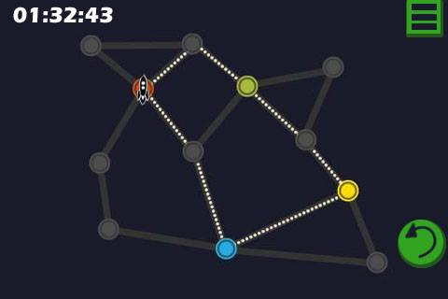
Gameplay
Notes:
The user’s path is completed when they have circled back to their starting point. At which point the traveler will launch and start going through the path.

Slide 10
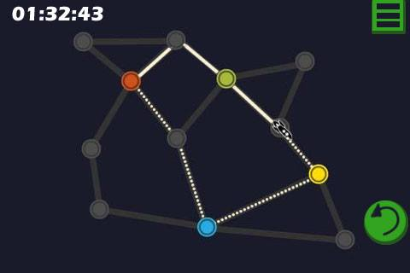
Gameplay
Notes:
The traveler will go through each node that the player has selected at a set speed. The timer will continue to run during their travels, which will affect their ending score.

Slide 11
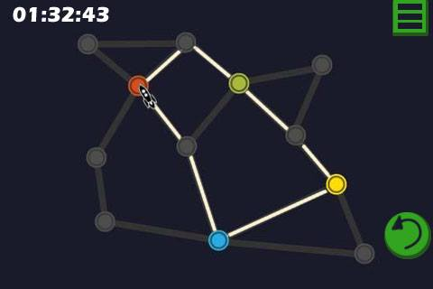
More Gameplay
Notes:
Once the traveler has returned to the starting point the timer will stop, and the next challenge will be generated and follow the same gameplay steps. There will be a total of 9 challenges per course (unless we change our minds), which get increasingly more difficult to solve.

Slide 12
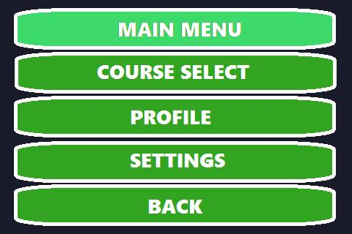
Option Menu
Notes:
At any point in the game, the player will be able to hit the option menu button at the top right of the screen. In this menu they are able to visit the “Main Menu”, go back to “Course Select”, view their “Profile”, change their “settings” such as changing the volume of the music and sound effects, or return to the previous screen.

Slide 13
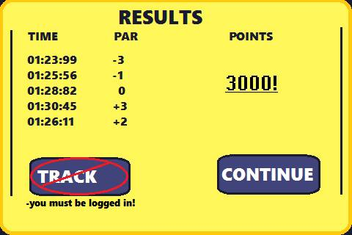
Results
Notes:
After completing all the challenges, a Results screen will pop up congratulating the player on completion. Here they will get feedback on their time and score. If the user is logged in, they will have the option of going to the “Track” screen and comparing their current attempt with their past scores. The “Continue” button will return the player to the course select screen. If they player has reached a certain number of points, the next level will be unlocked.

Slide 14
Flowchart
Notes:
Initially the user is shown a loading screen until the games data has been downloaded. Then they will be moved immediately upon loading to the main page, as you have seen before. From there you can either start playing the game, go to the main menu panel, or go to the sign in/sign up menu. The main menu contains access to the setting panel, which allows you to change the sound FX and music volumes, a link back to the main page, the course selection page, and access to your profile. Your account allows you to track your progress in the form of a chart, which has data on all of your recorded attempts on each different course,

Slide 15
Questions?

